Slide 1
Lecture 11:
A Unified theory for Community Ecology????

Slide 2
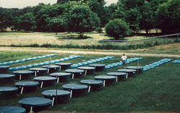
23 years ago…..A new PhD in
Community Ecology
“Community ecology may have the worst of all worlds…. It is not big and bold enough to break out of the overwhelming complexity…
…this begs the question of why ecologists continue to devote so much time and effort to traditional studies in community ecology. In my view, the time has come to move on”

Slide 3
Community Ecology over the last 15-20+ years—Exciting Developments!
Integrating local and regional processes
Explicit focus on scale and scaling
Connections to macroecology
Focus on pattern/process integration
Integrating temporal patterns and processes
Stability, dynamics
Connections to applied problems—Biodiversity change
Integration of food webs, mutualisms, disease, parasites, etc.
BEF research becoming more sophisticated
Bi-directional processes, natural environments
Efforts towards synthesis (often big data)
Data standardization
Strong analytical tools
GLMM
Hierarchical modelling (Bayesian)
Machine learning

Slide 4






















Organism/individual
Fitness
Behavior
Physiology
Etcetera
Population/ Metapopulation
Abundance
Growth/dynamics
Distribution
Community/Metacommunity
Coexistence/Assembly
Richness/diversity/Evenness
Scale and Beta-Diversity
Change through time (stability)
Food Webs and trophic structure (also mutualisms)
Biodiversity and ecosystem functioning (BEF)
Ecosystem fluxes and cycles
Time
Energy, Nutrients, water
Energy, Nutrients, water

Slide 5
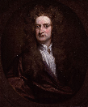
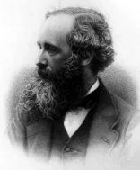
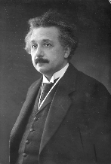
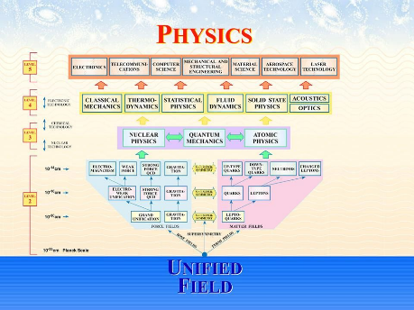
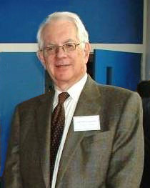
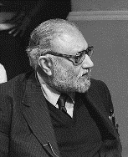
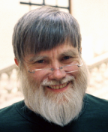
Unified Field Theory—
attempts to describe all fundamental forces and the relationships between particles in terms of a single theoretical framework.

Slide 6
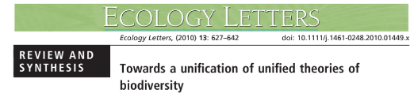
A unified theory is a theory that ties together branches formerly seen as separate and unconnected.
One might think ecology was too immature or too complex to support unified theories of its own.

Slide 7
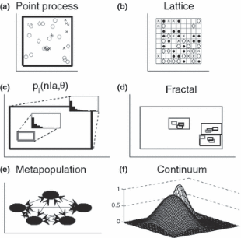
(at least) 6 unified theories
→ Predict multiple patterns (SAR, SAD, Distance-Decay)
Continuum/Niche
Fractal
Metapopulation
Neutral
Cluster Poisson
MaxEnt
Several others that didn’t fit nicely

Slide 8

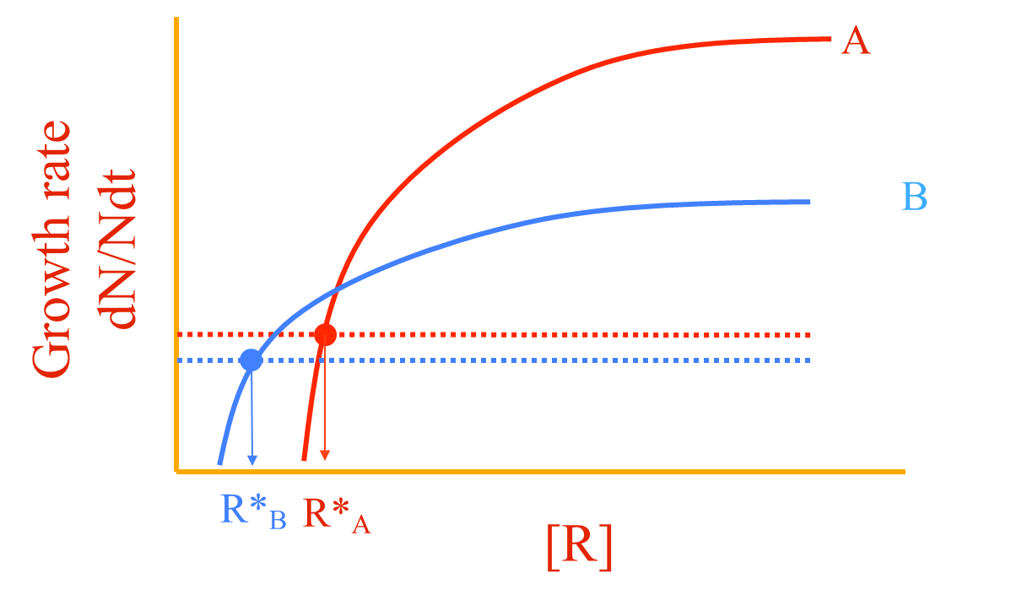
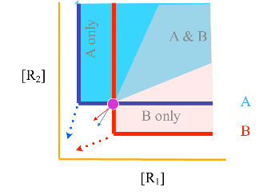
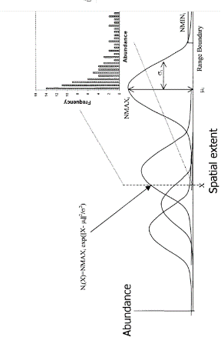
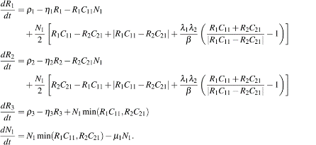
Continuum/Niche Theory
Linked Trade-Offs and Coexistence

Slide 9


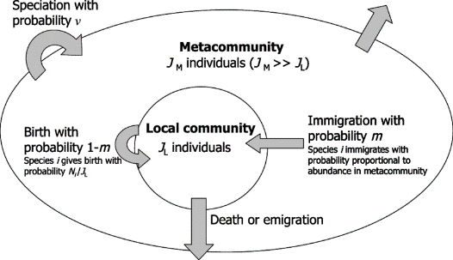
Unified Neutral Theory:
The ‘Neutral Theory’ provided an alternative framework to predict a number of commonly observed patterns in nature

Slide 10

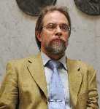
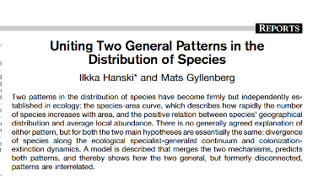
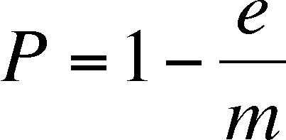
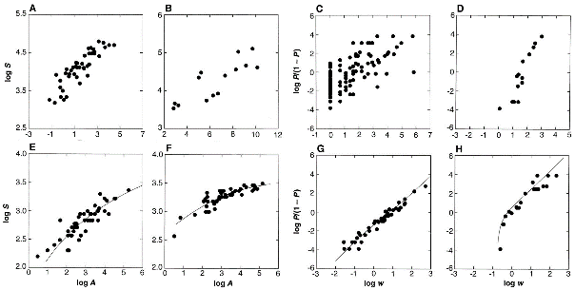
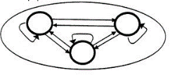
Metapopulation Ecology

Slide 11
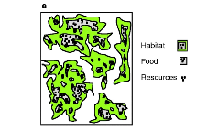
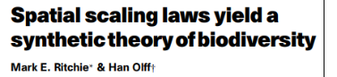
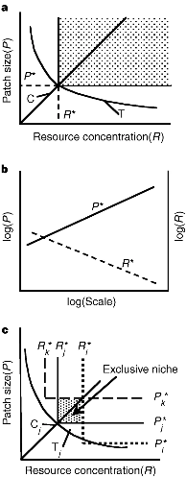
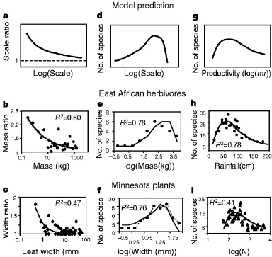


Fractal Model

Slide 12

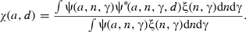
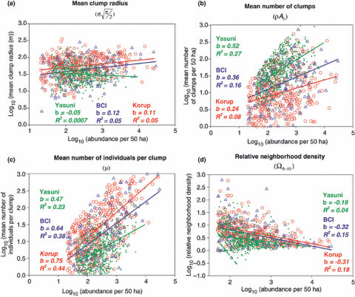
Clustered Poisson Point Processes
e.g, Morlon et al. 2008 Ecology Letters

Slide 13
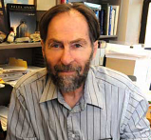
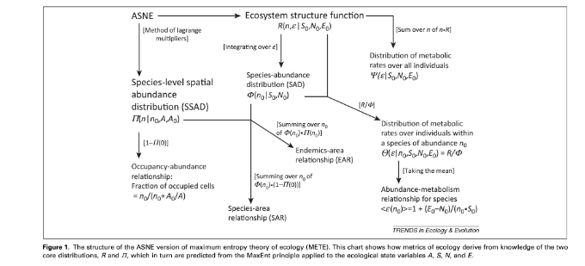

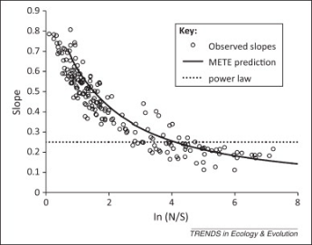
Maximum Entropy

Slide 14
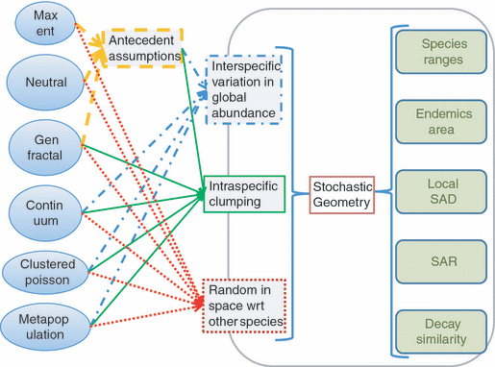

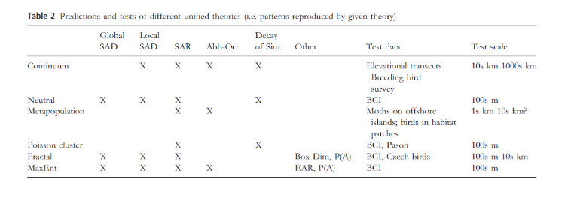
Focus on patterns

Slide 15
But wait….there’s more to unify
Unification to combine processes
Niche (selection) and Neutral (drift)
Dispersal, Selection, Drift, Speciation
Dispersal, Abiotic, Biotic
Focus on processes

Slide 16

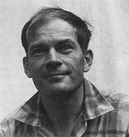

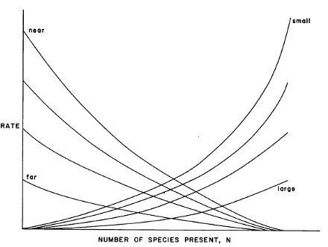
MacArthur’s Paradox:
An Early, but Incomplete, Synthesis
Deterministic (niche)
Stochastic (neutral)
Resource Ratio Model:
Basis for Niche Theory
Theory of Island Biogeography:
Basis for Neutral Theory

Slide 17
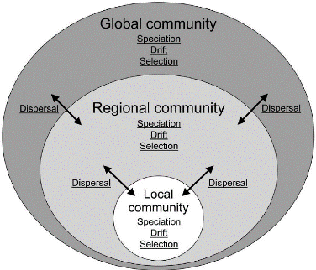

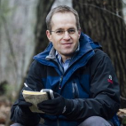
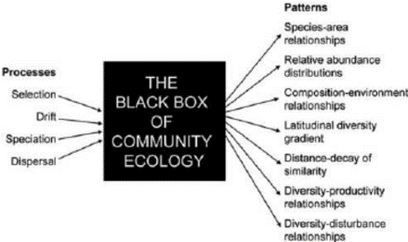
A Unified Community Theory

Slide 18



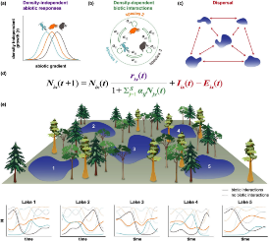
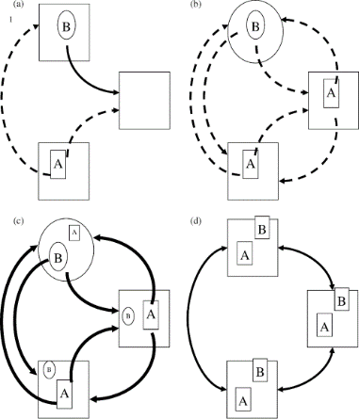



A Unified Metacommunity Theory
Leibold et al. 2004, Ecology Letters
Thompson et al. 2020, Guzman et al, 2022
Leibold and Chase 2018

Slide 19
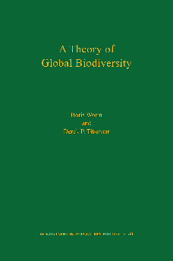

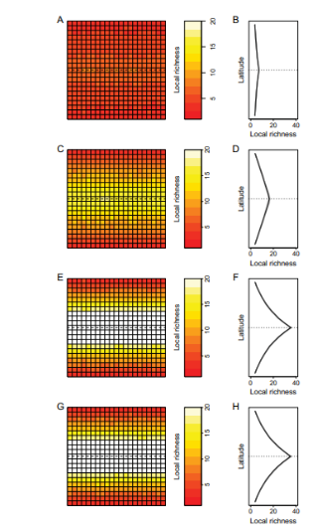

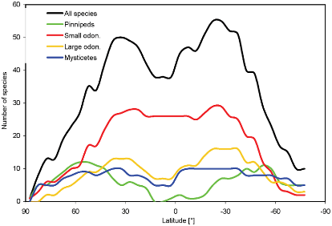
A Unified Biodiversity Theory

Slide 20
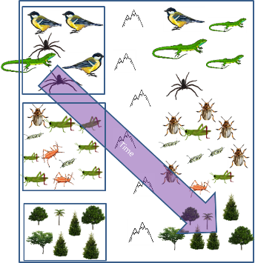
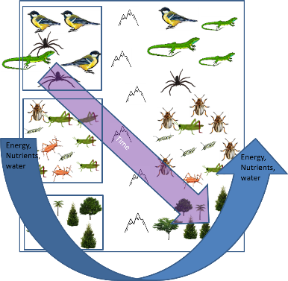
What about ‘Ecosystem’ Variables?
Biodiversity, abundance

Slide 21

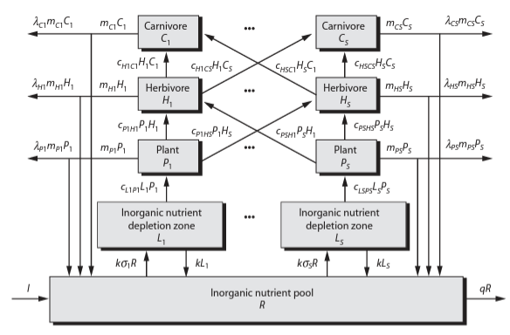
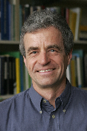
Link populations interactions to ecosystems via constraints
Energy
Nutrients
Predict Biodiversity-Ecosystem Function relationships (BEF)

Slide 22


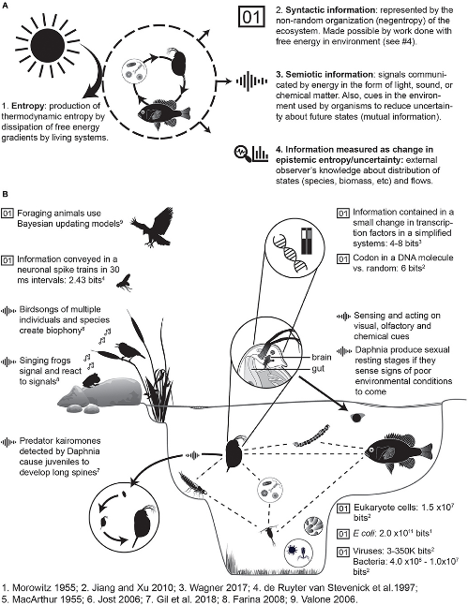
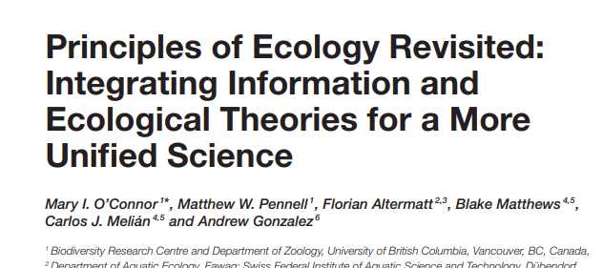
Constraints:
Information
Energy
Materials

Slide 23
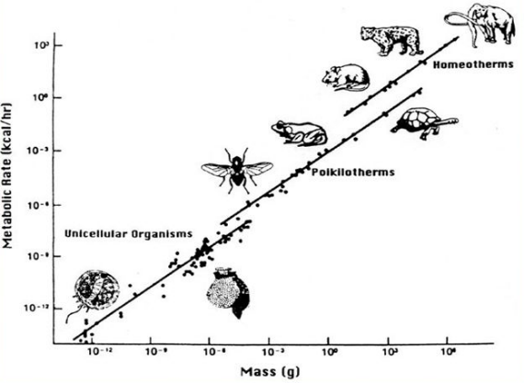
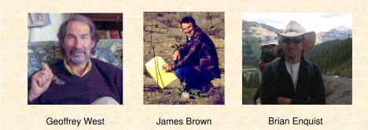
Back to First Principles.: Metabolism and Energy
¾ Scaling law

Slide 24
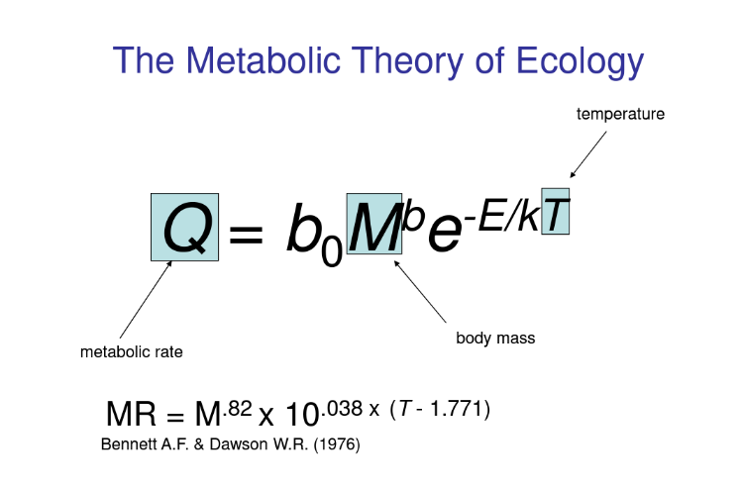

Slide 25


Slide 26


Slide 27


Slide 28

(West, Brown, Enquist)
(Dynamic Energy Budget)

Slide 29



Slide 30

Cabral et al. 2017, Ecography

Slide 31
Questions?

Slide 32
10 Minute Break
15 minute Breakout group discussion:
What are the most important elements for a unified theory?
Pattern vs. Process
First principles
energetics, metabolism
DNA/RNA
Stoichiometry
Population growth
Interactions
etcetera
How to build the structure?
Complex, simple, simulation, hierarchical?
15 minute full group discussion

Slide 33
Lecture 12:
Towards Prediction and Future Forecasts

Slide 34

Mechanistic Models and the “Many to One” Problem

Slide 35


Observing several patterns at once helps to disentangle
Looks neutral with fewer patterns
May et al. 2015. Proc. Roy. Soc. B

Slide 36


Empirical tests?

Slide 37



Model Predictions, Data fit

Slide 38

Approximate Bayesian Computation (ABC)
Leyshon 2021. https://towardsdatascience.com/the-abcs-of-approximate-bayesian-computation-bfe11b8ca341

Slide 39
“Einstein famously said that the ‘most incomprehensible thing about the universe is that it is comprehensible’.
Perhaps the key question in ecology today is the degree to which the dynamics of ecological communities are comprehensible.”
Godfray and May 2014: Are the dynamics of ecological systems predictable?. BMC Biology
“Ecology, with a few exceptions, has abandoned prediction and therefore the ability to demonstrate understanding.
A renewed commitment to prediction would allow ecologists to address critical questions about the generalizability of our results and the progress we are making towards understanding the natural world.”
Houlahan et al. 2016 The priority of prediction in ecological understanding. Oikos

Slide 40




Towards “Predictability”: Mechanistic vs. statistical
Peters, 1991

Slide 41



Darwin’s Entangled Bank: Emphasize complex mechanisms
"It is interesting to contemplate a tangled bank. [with different species] dependent upon each other in so complex a manner, have all been produced by laws acting around us”
Newton’s Laws: Emphasize Patterns

Slide 42

“Instead of focusing on tangles, Newton would have us focus on general patterns (“two or three general Principles”) from which state variables can be predicted”

Slide 43
A potential “Newtonian” model of ecology
Identify the ecological state variables of natural systems whose variation would be useful to predict.
-Biomass, diversity, dynamics
Discover ‘variation’ in that variable and its relationship with other variables
-Correlations, regressions, etc
-produce a model for prediction.
3. Test the model with independent data sets
4. If the model is ‘predictive’, test potential causal links
5. Once there is a predictive pattern and a causal link, then propose and test hypotheses about mechanisms that could give rise to the pattern.

Slide 44



Phosphorus input → variation in algal production (Chlorophyll a)

Slide 45

How we develop predictive models depends on goals
Evans 2012. Philosophical Transactions of the Royal Society

Slide 46

How we develop predictive models depends on scale
Mouquet et al. 2015 Journal of Applied Ecology

Slide 47
Extrapolation/Interpolation→
→In space
Allows us to take limited data and make predictions at other spatial scales
→In time
Allows us to make projections into the future
→Projections under different scenarios
-Climate change, land use, etcetera

Slide 48





Slide 49



Upscaling biodiversity: Extrapolations in Space
Kunin et al. 2018 Ecol. Monog.

Slide 50

Machine and Deep Learning in Ecology (e.g., classification)

Slide 51

Machine Learning for Future projections

Slide 52
Questions?
5 minute Break
Discussion: Statistical vs Mechanistic prediction?
10 minutes breakout group
5 minutes whole group

Slide 53


Bending the Curve
Forecasting, Scenarios and Projections

Slide 54



Slide 55




Slide 56



Slide 57



Slide 58


Slide 59




Scenarios of Biodiversity Drivers
Pereira et al. 2010 Science

Slide 60


Scenarios of response
Pereira et al. 2010 Science

Slide 61


Simple statistical relationships and scenarios
Di Marco et al. 2019, Global Change Biology

Slide 62




Forecasting using Neural Networks: Example with Bark Beetles
Rammer and Seidel 2019
Frontiers in Plant Science

Slide 63

Uncertainties in forecasting extinctions
Ladle 2009. Diversity

Slide 64



Urban et al. 2016 Science

Slide 65




Adding Models and Observations
S (Metacommunity)
S (Geometry alone)
Kehoe et al. 2017
Semenchuk et al. 2022

Slide 66



Purves et al. 2013
Madingly Model (Harfoot et al. 2014)
https://www.nature.com/articles/493295a
Hoeks et al. 2021. Global Ecology and Biogeography. MadinglyR

Slide 67




Present
Future

Slide 68



Prototype:
Computing infrastructure ←→ Research Infrastructure
Advanced models for simulation and prediction
Employs FAIR data combined with infrastructure, predictive modelling and AI.
Responds to key policy initiatives, including the EU Biodiversity Strategy 2030

Slide 69


Slide 70
Questions?
5 minute break
15 minute discussion (whole group)

